Slide 1

Welcome!
Sunday
  Bible Study 9:30 AM
  Worship 10:30 AM
  PM Bible Class (Livestream) 5:00 PM
Wednesday
  Bible Class 7:00 PM
www.SunsetchurchofChrist.net

Slide 2
John 6:60-71
Departure of many disciples
Offended
Lack of understanding

Slide 3
John 6:60-71
Departure of many disciples
The Words of Jesus are Life
Obtaining eternal life through them
Consuming His words
Coming to Him by these words

Slide 4
John 6:60-71
Departure of many disciples
The Words of Jesus are Life
Peter’s (all) confession
Identification of Judas as the betrayer

Slide 5
John 7:1-10
Feast of the Tabernacles
September
Dwelling in tents

Slide 6
Welcome!
Sunday
  Bible Study 9:30 AM
  Worship 10:30 AM
  PM Bible Class (Livestream) 5:00 PM
Wednesday
  Bible Class 7:00 PM
www.SunsetchurchofChrist.net

Slide 7

Opening Prayer | Lamar McDonald
Song – 44 | George Watkins
Scripture Reading | Ryan Sollars
Song – 225 | George Watkins
Song – 164 | George Watkins
Lord’s Supper | Ryan Sollars, Anthony Ward
Song – 75 | George Watkins
Collection | Ryan Sollars, Anthony Ward
Song – 347 | George Watkins
Lesson | Brian Haines
Song – 307 | George Watkins
Closing | Grant Haines

Slide 8

You are wearing that?

Slide 9

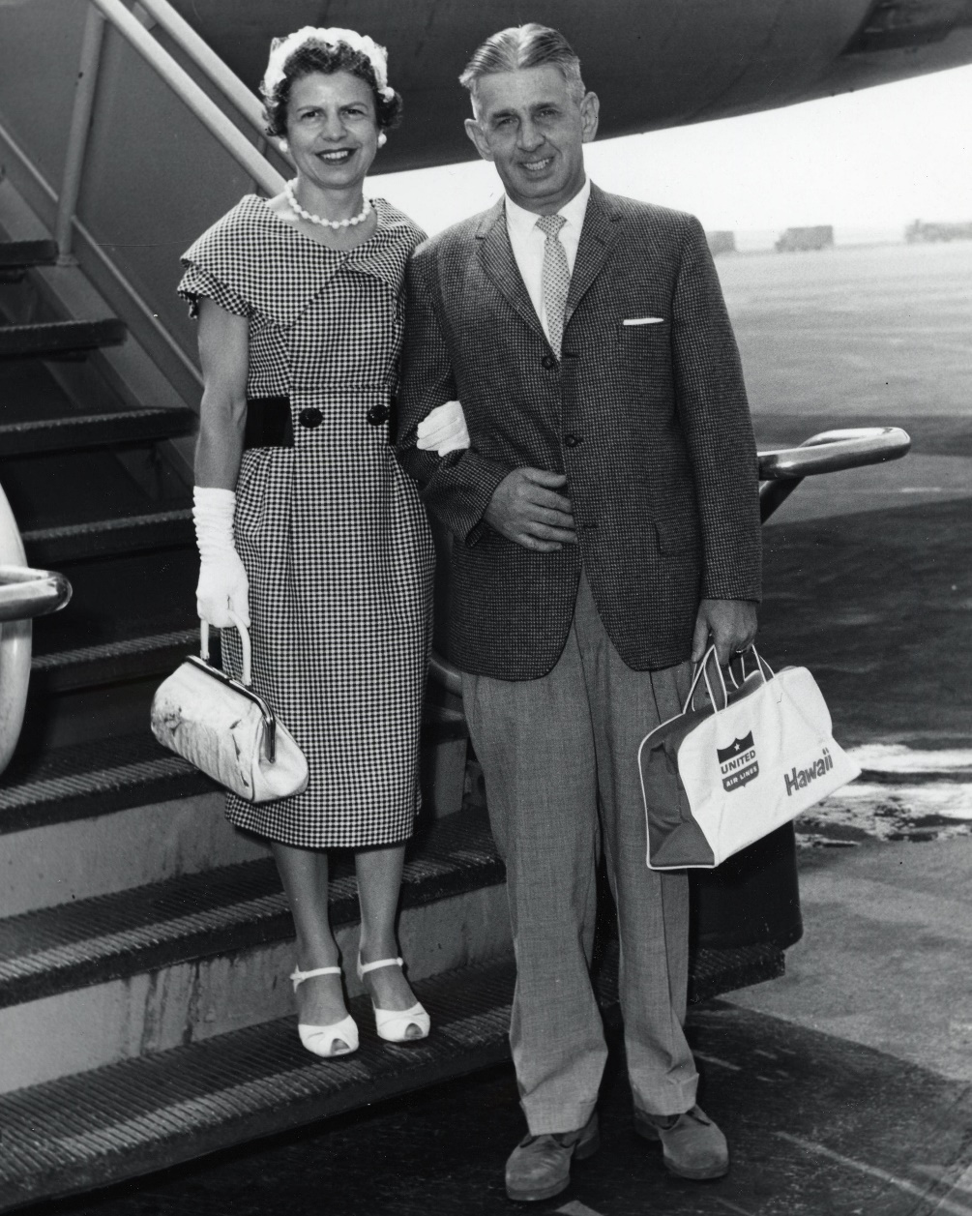
Notes:
Time are changing, and what is considered appropriate for dress up is changing.

Slide 10
Clothes in the Bible
Genesis 3:7
Then the eyes of both of them were opened, and they knew that they were naked; and they sewed fig leaves together and made themselves coverings.

Slide 11
Clothes in the Bible
Genesis 3:7,21
Also for Adam and his wife the LORD God made tunics of skin, and clothed them.

Slide 12
Clothes in the Bible
Genesis 3
Genesis 37:3
Israel loved Joseph more than all his children, because he was the son of his old age. Also he made him a tunic of many colors.

Slide 13
Clothes in the Bible
Genesis 3
Genesis 37
Exodus 28:40-43
For Aaron's sons you shall make tunics
Notes:
Ex 28:40 ¶ "For Aaron's sons you shall make tunics, and you shall make sashes for them. And you shall make hats for them, for glory and beauty. 41 "So you shall put them on Aaron your brother and on his sons with him. You shall anoint them, consecrate them, and sanctify them, that they may minister to Me as priests. 42 "And you shall make for them linen trousers to cover their nakedness; they shall reach from the waist to the thighs. 43 "They shall be on Aaron and on his sons when they come into the tabernacle of meeting, or when they come near the altar to minister in the holy place, that they do not incur iniquity and die. It shall be a statute forever to him and his descendants after him.

Slide 14
Clothes in the Bible
Genesis 3
Genesis 37
Exodus 28
Leviticus 19:19
Nor shall a garment of mixed linen and wool come upon you.
Notes:
Le 19:19 ¶ 'You shall keep My statutes. You shall not let your livestock breed with another kind. You shall not sow your field with mixed seed. Nor shall a garment of mixed linen and wool come upon you.

Slide 15
Clothes in the Bible
The Old Testament reveals:
Clothing matters
Clothing elicits carnal responses
Clothing frames mindset
How does the New Testament apply?
Notes:
Le 19:19 ¶ 'You shall keep My statutes. You shall not let your livestock breed with another kind. You shall not sow your field with mixed seed. Nor shall a garment of mixed linen and wool come upon you.

Slide 16
Christians and Clothing
Modesty and decency
Honor and respect
Judgment and discernment

Slide 17
Modesty and Decency
In like manner also, that the women adorn themselves in modest apparel, with propriety and moderation, not with braided hair or gold or pearls or costly clothing, 1 Timothy 2:9
Notes:
1Ti 2:9 ¶ in like manner also, that the women adorn themselves in modest apparel, with propriety and moderation, not with braided hair or gold or pearls or costly clothing,

Slide 18
Modesty and Decency
Do not let your adornment be merely outward--arranging the hair, wearing gold, or putting on fine apparel-- rather let it be the hidden person of the heart, with the incorruptible beauty of a gentle and quiet spirit, which is very precious in the sight of God. 1 Peter 3:3
Notes:
1Ti 2:9 ¶ in like manner also, that the women adorn themselves in modest apparel, with propriety and moderation, not with braided hair or gold or pearls or costly clothing,

Slide 19
Modesty and Decency
Modesty:
Making character our emphasis
Desire for humility and contentment
Absence of making a statement
Notes:
1Ti 2:9 ¶ in like manner also, that the women adorn themselves in modest apparel, with propriety and moderation, not with braided hair or gold or pearls or costly clothing,

Slide 20
Modesty and Decency
Immodesty:
Drawing attention by flash and show
Emphasis on physical over spiritual
Reflection of wealth and style
Notes:
1Ti 2:9 ¶ in like manner also, that the women adorn themselves in modest apparel, with propriety and moderation, not with braided hair or gold or pearls or costly clothing,

Slide 21
Which one is the most modest?
Notes:
Time are changing, and what is considered appropriate for dress up is changing.

Slide 22
Modesty and Decency
We often confuse modesty and decency
Indecent
- Sexually revealing
- Inciting lust
Matthew 18:7 – Stumbling blocks
Notes:
Mt 18:7 ¶ "Woe to the world because of offenses! For offenses must come, but woe to that man by whom the offense comes!

Slide 23
Modesty and Decency
We often confuse modesty and decency
Often decency is culturally defined
We need to err on the side of love
Notes:
Mt 18:7 ¶ "Woe to the world because of offenses! For offenses must come, but woe to that man by whom the offense comes!

Slide 24
Honor and Respect
Clothing reflects our respect for others
At a wedding or funeral
In the grocery store
Respect what is right in the sight of all men. Romans 12:17
Notes:
Mt 18:7 ¶ "Woe to the world because of offenses! For offenses must come, but woe to that man by whom the offense comes!

Slide 25
Honor and Respect
Clothing reflects our respect for others
Clothing reflects who we want seen
Priestly garments
Tassels on the garments
Notes:
Mt 18:7 ¶ "Woe to the world because of offenses! For offenses must come, but woe to that man by whom the offense comes!

Slide 26
Judgment and Discernment
James 2:1-4
Judges with evil thoughts
Modesty, decency and respectful:
Matters of judgment
Matters of certainty
Notes:
Jas 2:1 ¶ My brethren, do not hold the faith of our Lord Jesus Christ, the Lord of glory, with partiality. 2 For if there should come into your assembly a man with gold rings, in fine apparel, and there should also come in a poor man in filthy clothes, 3 and you pay attention to the one wearing the fine clothes and say to him, "You sit here in a good place," and say to the poor man, "You stand there," or, "Sit here at my footstool,“ 4 have you not shown partiality among yourselves, and become judges with evil thoughts?

Slide 27
What Are You Wearing?
Christians are mindful of what they wear
How clothing impacts others
How clothing reflects respect
Christians are careful in their judgment
Discerning in opinions
Notes:
Jas 2:1 ¶ My brethren, do not hold the faith of our Lord Jesus Christ, the Lord of glory, with partiality. 2 For if there should come into your assembly a man with gold rings, in fine apparel, and there should also come in a poor man in filthy clothes, 3 and you pay attention to the one wearing the fine clothes and say to him, "You sit here in a good place," and say to the poor man, "You stand there," or, "Sit here at my footstool,“ 4 have you not shown partiality among yourselves, and become judges with evil thoughts?

Slide 29

Putting On Christ
For all of you who were baptized into Christ have clothed yourselves with Christ. Galatians 3:27
"Behold, I am coming as a thief. Blessed is he who watches, and keeps his garments, lest he walk naked and they see his shame.“ Revelation 16:15
Notes:
Ac 15:11 "But we believe that we are saved through the grace of the Lord Jesus, in the same way as they also are."

